Slide 1
Case Study Pt. II
Sean Villoresi and Matthew O’Donnell

Slide 2
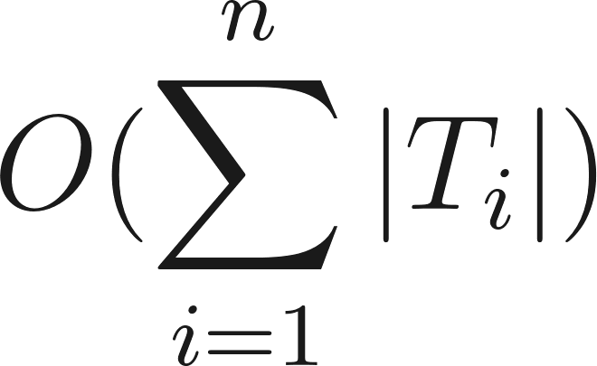
Task 1: Approach 2
The Algorithm:
Find midpoint of longest trajectory
Pair midpoint with closest point in all other trajectories
Sequentially (like passage of time) put all trajectories’ points in bins so that the paired points from the previous step are in the same bin
Compute the average coordinates of the points in each bin
For each trajectory, compute an error sum for that sums the distance from the trajectory’s points to the average coordinates in its assigned bin.
Return the trajectory with the minimum error sum
Runtime: Our approach is because we iterate over all the points in each trajectory three times
First to find the closest point to the long trajectory’s midpoint
Second to assign the trajectory’s points to the right bins
Third to sum the error for each point-bin assignment

Slide 3
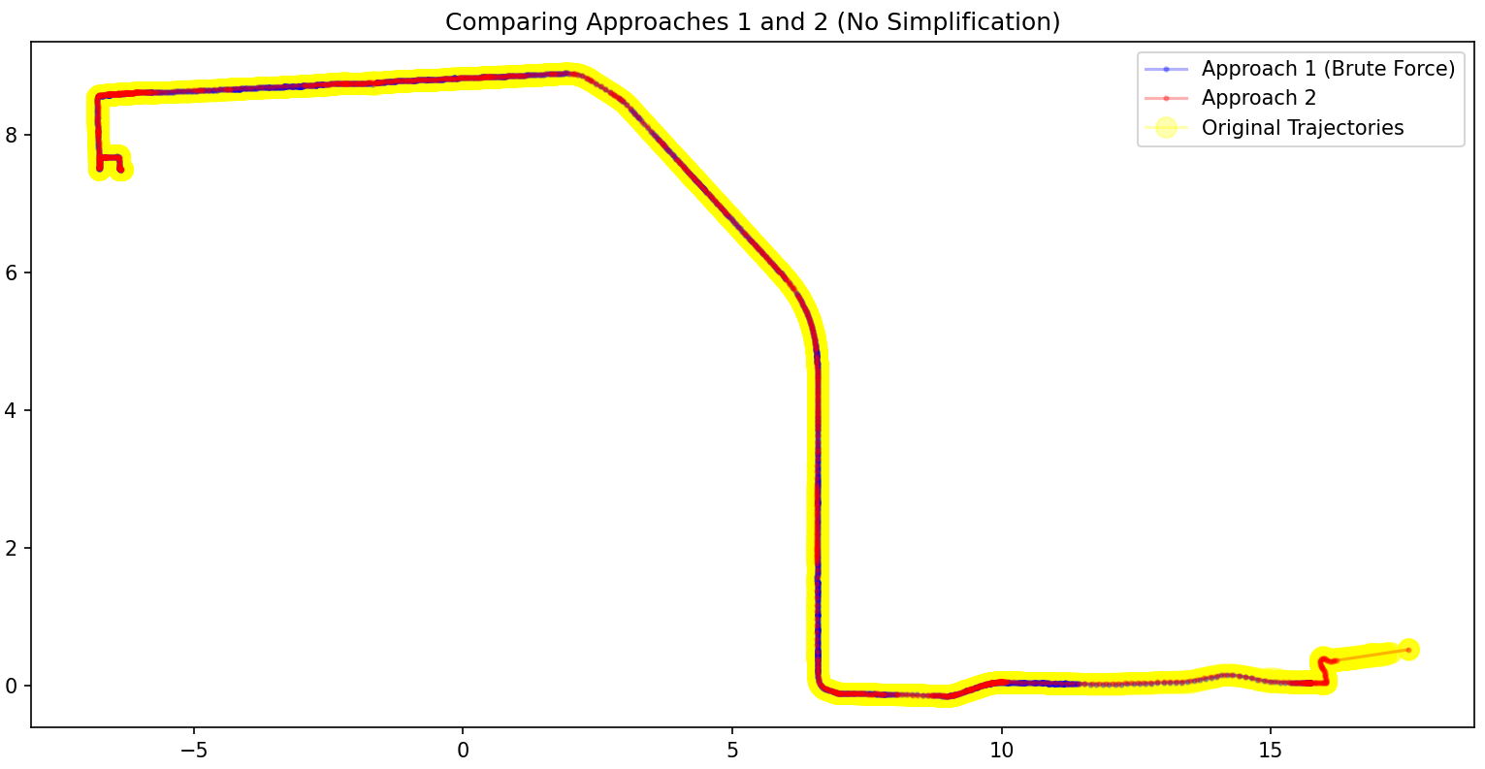
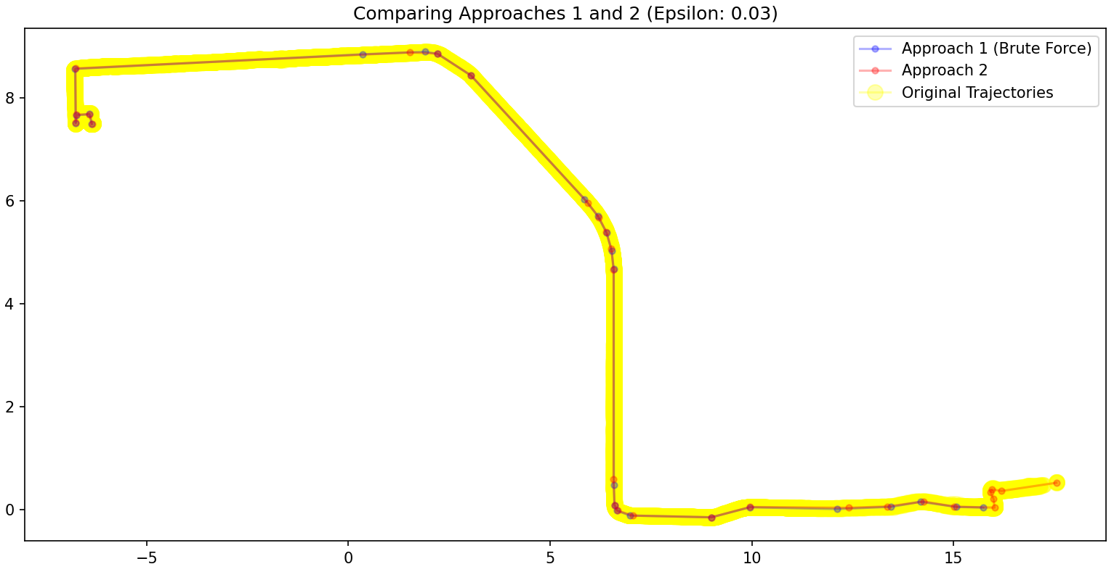
Task 1: Experimental Results (Slide 1)

Slide 4
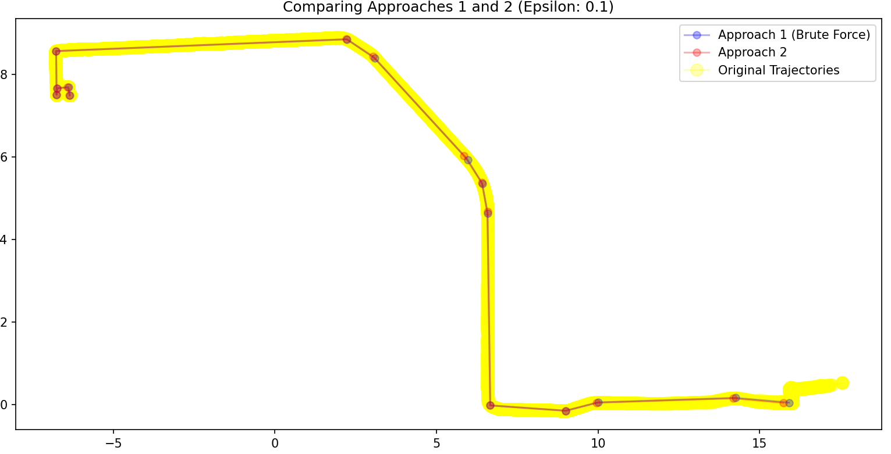
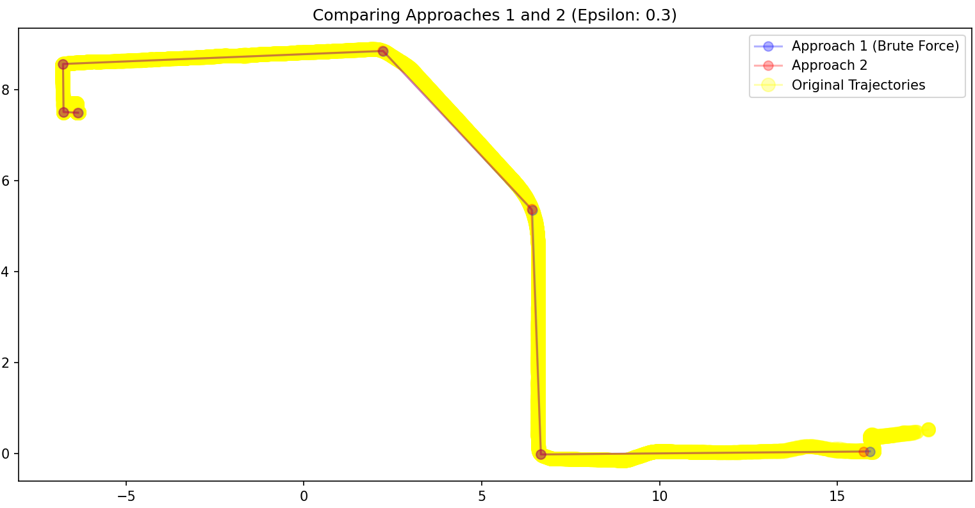
Task 1: Experimental Results (Slide 2)

Slide 5
Task 1: Comparing Approaches
Approach I:
Strengths:
Returns optimal (pre existing) trajectory for minimizing cost
Return trajectory is pre existing… follows natural path of a vehicle unlike some messy point averaging methods we tried
Weaknesses:
Slow! O(n^2M^2) Quadratic (or worse) with respect to total number of points
Approach II:
Strengths:
Fast! Linear with respect to total number of points
Return trajectory is pre existing… follows natural path of a vehicle unlike some messy point averaging methods we tried
Still pretty accurate!
Weaknesses:
Return trajectory is usually not the best trajectory in the set.

Slide 6
Task 2: Proposed Seeding Method
Algorithm chooseNextCenter:
Our algorithm essentially uses a k-means clustering approach, but translated to work for trajectories.
We choose our centers randomly, where each trajectory is assigned a weight based on its closest center(with the weight being distance itself)
Our algorithm ensures that our centers will be far apart from each other, which makes it easier to avoid getting “stuck” in a sub optimal spread.
Algorithm ourSeed
ourSeed merely calls chooseNextCenter, passing it the proper parameters(our set of trajectories and our desired number of clusters
Runtime: The runtime as a whole of ourSeed would be O(kn^2), where k is the number of clusters and n is the number of trajectories. While the n^2 is undesirable, we only run our seeding method once, and our code more then makes up for speed in other aspects.

Slide 7
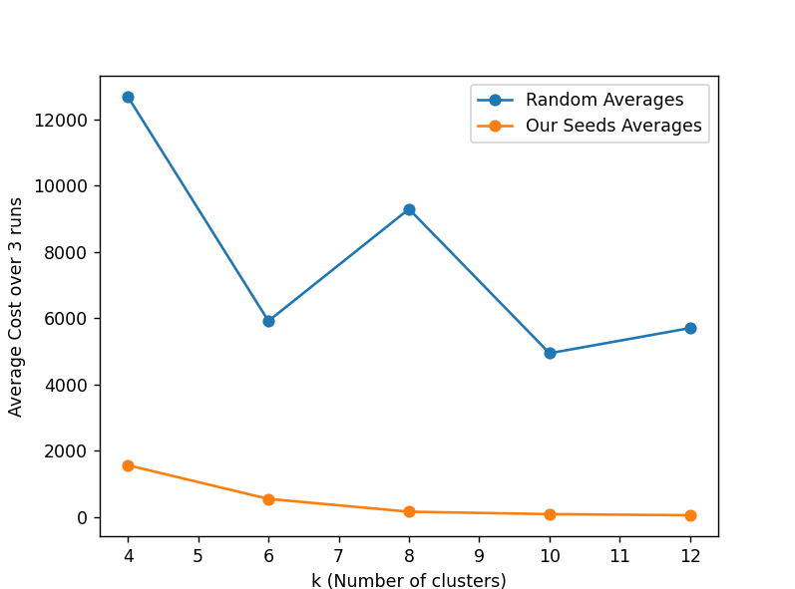
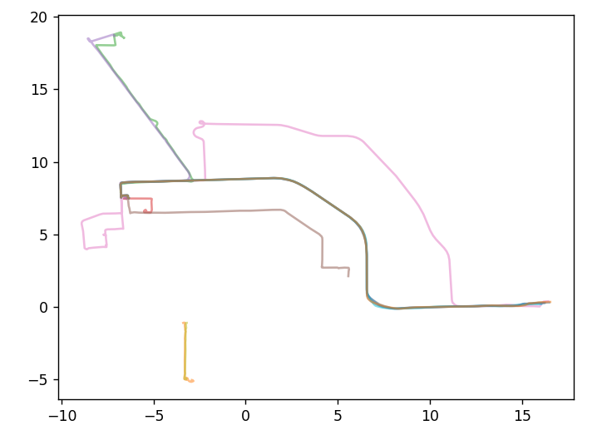
Task 2: Experimental Results
Actual Trajectory Mapped
Epsilon = .01, k =12
.01 epsilon chosen after trying many as the best balance between precision and time

Slide 8
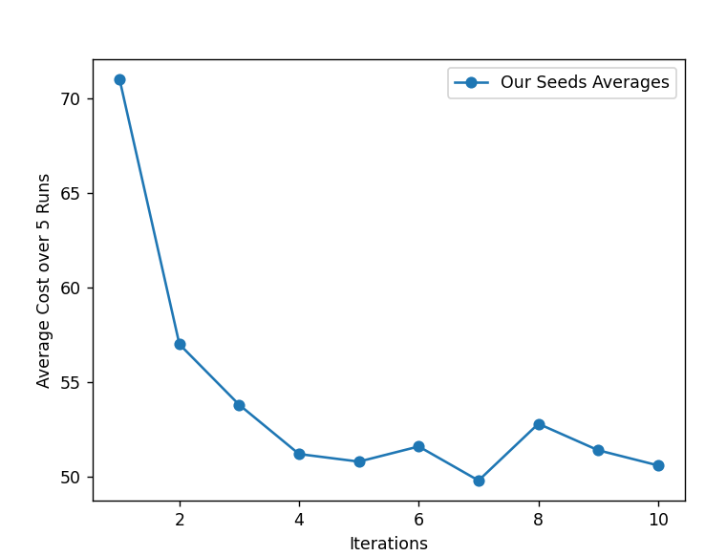
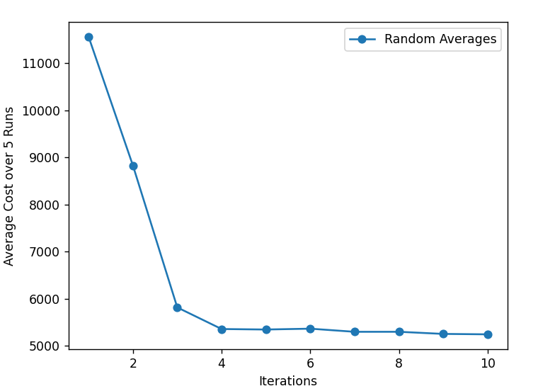
Task 2: Experimental Results
Our Seeds setup starts incredibly well, to the point where not much optimization is need
Random setup starts poorly, and can only be optimized so much

Slide 9
Task 2: Choosing k
If k is not predetermined, our best approach would be to use a method of determining how many “hubs” there are.
As we can see through our test cases, 4 and 6 clusters generally had a much worse average clustering cost
It seems that no matter how optimal the few center trajectories are, they cannot properly encompass all the trajectories in our data set
8-12 trajectories had much better results, 12 being the best for our proposed seeding method
If we wanted to determine this without running empirical test cases, we could use some variation of our hubs method from part 1 (potentially changed to map trajectory density. You could determine how many trajectory “hubs” there are, and use this to determine how many clusters/groupings of trajectories we should be looking for.

Slide 10
Task 2: Alternative Approach to Clustering Trajectories
Density Based- Approach
Another way we could have approached clustering trajectories would have been through a density-based approach
Here is how this could be implemented:
Take a Random Trajectory, see how many trajectories are within a predetermined distance of this trajectory (using a distance metric like DTW)
If the number of close trajectories is greater than a predetermined threshold, create a cluster using that trajectory as a center, otherwise ignore and repeat
Repeat this until all trajectories have been assigned to a cluster, or until you have created a certain number of clusters

Slide 11
Contributions:
Matthew O’Donnell
Implemented Approach II for task 4
Implemented Random Seed for task 5
Implemented half a of Lloyds
Did most of task 4 slides
Sean Villoresi
Implemented Approach I for task 4
Implemented our proposed seeding method for task 5
Implemented half of Lloyds
Did most of task 5 slides

